Slide 1

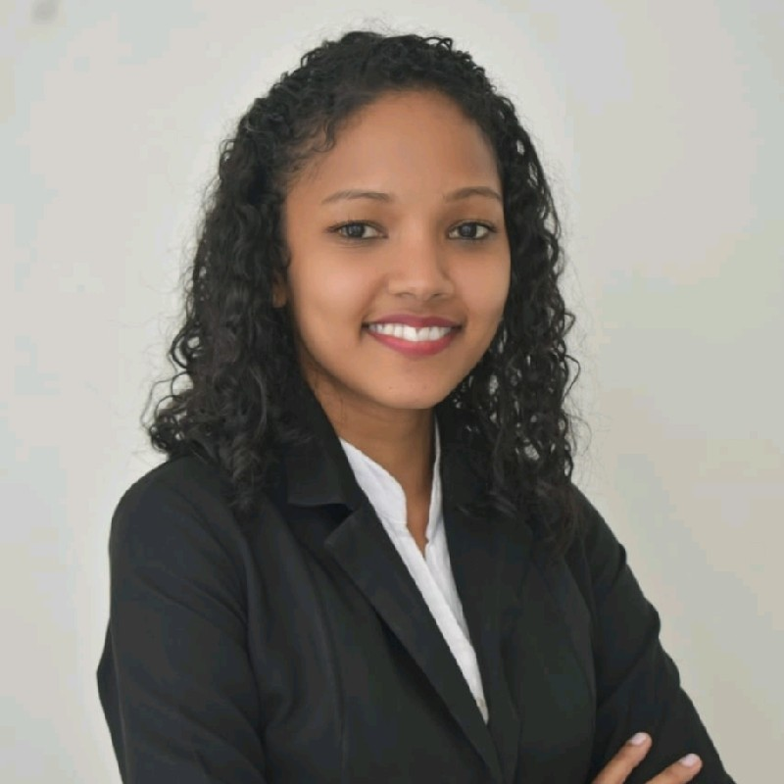


Experience
Areas of expertise
Data Engineer( May 2021 - Present) AZ-900 certification training
IT Analyst for Audit Company (April 2019 – May 2021)
Providing IT application support to the company clients. Traineeship in System Analyst department (Aug 2018 – Nov 2018)
Application development
Functional
Software Engineering
Testing abilities​
Analytical abilities
Industries
Audit
Airline
Technical
Web (HTML5/CSS/JS)
ASP.NET
C#
SQL
PL/SQL
Azure
SharePoint
Kelly Marie Lauriana ZAMA
Data Engineer
Application Development Analyst Ebène, Mauritius.
Education
Professional background
BSc(Hons) Software Engineering
University of Technology, Mauritius, 2019
Certifications
Microsoft Azure Fundamentals - AZ – 900
Sofwatre engineering graduate with 2+ years of experience in multiple IT sectors, with various technologies.​
I'm a well-organized and highly
motivated person. I always strive
to achieve the highest standard
possible at any given task in any
situation.

